Slide 1
NERVE INJURIES : DIAGNOSIS, EVALUATION AND MANAGEMENT

Slide 2
APPROACH
Fundamentally clinical :
Through History
Neurological Ex.
Investigations

Slide 3
Questions to be answered –
- Mechanism of injury ?
- Severity ?
- Focal Vs diffuse injury ?
- Nerve element lacerated or in continuity ?
- Complete or incomplete injury ?
- Static, improving or deteriorating ?
Worsening may be d/t – Hematoma, Compartment syndrome
or pseudoaneurysm

Slide 4
HISTORY
High index of suspicion
- In 5% of pts with poly trauma
Rule of thumb – To exclude injury, most distal part of nerve
should be in function
1- Pain: may be d/t –
- Disuse phenomenon
- Compression
- Autonomic dysfunction
- Neuroma Formation

Slide 5
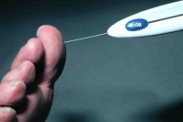
2- Sensory Loss
- Anesthesia
- Hypoesthesia
- Hyperesthesia
- Dysesthesia
- Allodynia
3- Motor Deficit
- Location
- Severity
- Change in motor function loss – Motor march
4- Autonomic dysfunction
- Sweating – loss or increased
- Coolness
- Cyanosis

Slide 6
NEUROLOGICAL EXAMINATION
No alternative to a proper and through neurological ex.
: General Principal :
1- Proper exposure
2- Comparison
3- Systematic and orderly approach – proximal to distal
4- Assessment and grade of individual muscles
5- Awareness of adaptive movements

Slide 7
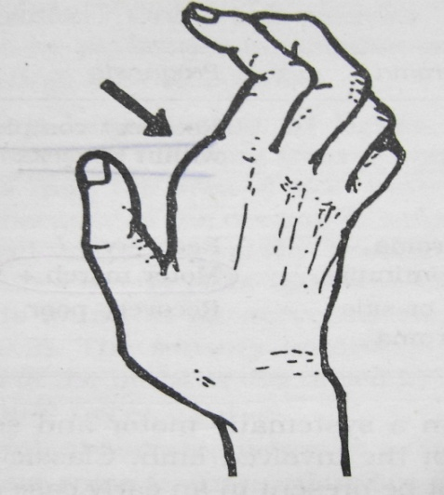
1- Abnormal posture :
- Waiter tip
- Wrist and finger drop
- Claw hand
- Ape hand
- Foot drop
2- Motor examination :
- Muscle bulk
- Tone
- Power of individual muscles

Slide 8
Motor function assessment (LSUMC system):
• MO: Complete paralysis
• Ml: Palpable muscle contraction
• M2: Active joint motion with elimination of gravity
• M3: Contraction or full joint motion against gravity
• M4: Contraction or full joint motion against gravity and
resistance
• M5: Full range of motion - Normal contraction
3- Reflexes :
- Extremely sensitive indicator
- Do not return even recovery of sensation and
muscle function

Slide 9
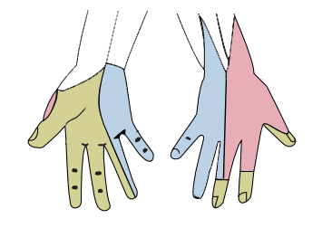
4- Sensory Evaluation :
Principle - Ex. of autonomic zones of innervation in
which least likelihood of sensory overlap
(A) – All modalities to be tested
(B) – Distribution of sensory loss
(C) – Paresthesia -
- Distribution
- Quality
- Severity
- Continuous or intermittent
- Precipitating, exacerbating and ameliorating
factors
Wikimedia.org.Gray812and814_hand.png

Slide 10
Following scale (LSUMC system) can be used:
• SO: Absence of sensation in an autonomous area
• Sl: Presence of deep cutaneous pain and sensation
• S2: Presence of some degree of superficial cutaneous pain,
tactile sensation, and two-point discrimination
• S3: Presence of appreciable sensation, but no localization
• S4: Presence of sensation with diminished acuity
• S5: Normal sensory function
5- Sympathetic Functions :
- Sympathetic fiber : Most resistant
- Usually confined to hand or feet
- Sweating (Starch test)
- Color and temperature of affected part
- Trophic changes

Slide 11
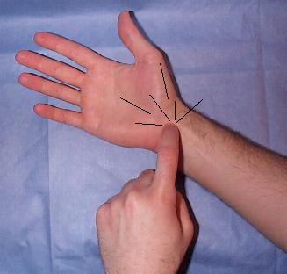
5- Local examination :
- Neuroma
- Tinel’s sign
: Elicited from below upward
: Advancing along the anatomical distribution of the
nerve, particularly at the expected rate of nerve
regeneration – e/o ongoing regeneration
- Associated bony or vascular injury
- Any contracture or deformity
- Presence of an aneurysm and its relationship to a
neighboring nerve
www.med.und.edu

Slide 12
NERVE INJURY : Clinical grades
CLINICAL GRADE CRITERIA
1- Mild 1- Intermittent symptoms
(e.g. Dysthesias, Pain,
Numbness)
2- Moderate 2- Constant symptoms
without e/o axonal loss
3- Severe 3- E/o axonal loss – muscle
atrophy, abnormal two
point discrimination or
both

Slide 13
: NERVE INJURY CLASSIFICATION :
SEDDON CLASSIFICATION
NEUROPRAXIA | AXONOTMESIS | NEUROTMESIS
Physiological conduction block Segmental demyelination Disproportionate motor over sensory loss with sparing of autonomic function Recovery – Hrs to days Crutch palsy Saturday nerve palsy Tourniquet palsy | Axonal interruption Nerve in continuity Axon disintegrate – phagocytosis – Wallerian degeneration Outcome – No return to v. good return of function Regeneration at the rate of 1 mm / day | Division of nerve trunk Endoneural tube destroyed to variable length Regenerating fibres+schwann cells+fibroblasts =Neuroma Almost always require repair

Slide 14
: NERVE INJURY CLASSIFICATION :
SUNDERLAND CLASSIFICATION
Sunder land | Seddon | Epineurium | Perineurium | Endoneurium | Axon | Outcome
1 | Neuropraxia | + | + | + | Block | Good
2 | Axonotmesis | + | + | + | _ | G / fair
3 | Axonotmesis | + | + | _ | _ | F /poor
4 | Axonotmesis | + | _ | _ | _ | Poor
5 | Neurotmesis | _ | _ | _ | _ | Poor

Slide 15
Peripheral Nerve Injuries of the Upper Limb
: Axillary nerve (C5,6) injury :
Causes :
- Dislocation or reduction of shoulder
- # of surgical neck of humerus
- IM injection high in the post.
aspect of the shoulder
- After sleeping in a prone
position with the arm raised
above the head

Slide 16
S/S:
- Loss the sensation over the
“regimental badge” area
- Flattening of the shoulder
- Deltoid muscle weakness

Slide 17
:Musculocutaneous nerve (C5,6,7)injury:
Causes:
- Usually along with BPI
- Proximal humerus #
- Shoulder dislocations
- Carpet carrier's palsy
S/S:
- Weakness of elbow flexon
- Weakness of arm flexio
- Weakness of supination
- Loss of sensation at lat.
border of forearm

Slide 18
:Radial nerve (C5,6,7,8,T1) Injury:
M.C. site – Spiral Groove
Cause :
- IM injection in Triceps
- Saturday night palsy
- Crutch paralysis
- # Shaft of humerus

Slide 19
S/S :
- Paresis or paralysis of
extension of the elbow
- Paresis of supination of
forearm
- Wrist drop
- Sensory loss over a narrow
strip on back of forearm and
on the lateral side of dorsum
of hand
- Hypo or areflexia of triceps
and brachioradialis jerk

Slide 20
:Ulnar Nerve (C7,8,T1) injury :
M.C. site - Medial epicondyle, or a little more
distally where the nerve enters the
forearm b/w the two heads of flexor
carpi ulnaris
Causes: - # of medial condyle
- During anesthesia
S/S:
- Radial deviation of wrist on flexion
- Claw-hand deformity
- Paresthesia and sensory loss on hand

Slide 21
A- Egawa’s Test – Dorsal Interossei
B- Card Test – Palmer interossei
C- Book Test - Adductor pollicis
(Froment,s sign)

Slide 22
:Median nerve (C5,6,7,8,T1) injury:
CAUSES -
- Crutch compression
- Sleep paralysis
- Penetrating trauma
- Shoulder dislocation
S/S:
- Atrophy of the thenar
eminence
- Simian or ape hand
(d/t opponens pollicis)
- Benediction hand

Slide 23
- Paresis of forearm pronation
- Paresis of distal flexion of the thumb
- Paresis of radial wrist flexion
- Impaired opposition of the thumb
- Paresis of flexion of the second and
to a lesser extent, the third fingers
Pen Test – For Abductor pollicis brevis

Slide 24
Peripheral Nerve Injuries of the Lower Limb
:Sciatic nerve (L4,5,S1,2,3) injury:
Complete lesion - rare
Causes:
- Fracture dislocation of the hip
- Apophyseal avulsion fracture
- Hip joint surgery
- IM injection
- Gunshot wounds
- Femur fracture
S/S:
- Flail foot
- Wasting of the hamstrings and all
muscles below the knee

Slide 25
- Paresis or paralysis of
Knee flexion (hamstrings)
Foot eversion (peronei)
Foot inversion (tibialis anterior)
Foot dorsiflexion
(tibialis anterior and ant. leg muscles)
Foot plantar flexion
(gastrocnemius and soleus)
Toe dorsiflexion (ext. of the toes)
Toe plantar flexion
- Decrease or absence of the Achilles reflex
- High step gait
- Peroneal division > tibial division (75% of cases)

Slide 26
:Common peroneal nerve (L4,5,S1,2) injury:
M. C. Site - At the level of the
fibular head
Causes:
- Trauma
- During anaesthesia or coma
- Over tight or ill-fitting plaster
casts applied for leg fractures

Slide 27
S/S:
- Foot drop
- Variable sensory
disturbance affects the
entire dorsum of the
foot and toes and the
lateral distal portion of
the lower leg

Slide 28
:Tibial nerve (L4,5,S1,2,3) injury:
Causes:
- Trauma - Dislocation of the knee
S/S:
- Variable paralysis of plantar flexion of the
foot and toes
- Numbness of the heel and part of the sole
- Lateral side of the foot and posterior aspect
of the leg
Nerve may also be compressed in the fascial
tunnel behind the medial malleolus and this can lead to weakness
of the intrinsic muscles of the foot

Slide 29
:Femoral nerve (L2,3,4) injury:
Causes:
- Iatrogenic
- Penetrating gunshot and stab wounds
- Pelvic fractures

Slide 30
S/S:
- Weakness / Atrophy of the muscles of
the ant. part of the thigh causing
weakness of hip flexion
(iliacus, psoas, and rectus femoris)
- Inability to extend the leg
(quadriceps femoris).
- Impaired lateral thigh rotation
(Sartorius)
- Sensory loss, paresthesias on the
anteromedial thigh and inner leg
as far as the ankle.
- Patellar reflex depressed or absent

Slide 31
:Some Special Nerve Injuries :
A – Brachial Plexus injury in adults :
Incidence : 10% of PNS injuries
Ages 15 -30 yr,
Males
Usually closed
Stretch / traction – most common (90%)
Pre ganglionic or Post ganglionic

Slide 32
Law of Seven Seventies (Narakas)
70% traumatic lesions due to RTA
70% traffic accidents involve a cycle or motorcycle
70% of these pts have multiple injuries
70% supraclavicular injuries
70% of pts w/ supraclavicular lesions will have one or several
roots avulsed from the spinal cord
70% of pts w/ root avulsions will have lower roots C7, C8, or T1
avulsed
70% of pts w/ lower root avulsion will have persistent pain

Slide 33
Pre ganglionic Vs Post ganglionic
Neuropathic pain
Horners syndrome
Winging of scapula ( C6 )
Inability to move scapula medially ( C5 )
Involvement of phrenic nerve
Loss of sensation above clavicle
Fractures of C7 transverse process ,first rib

Slide 34
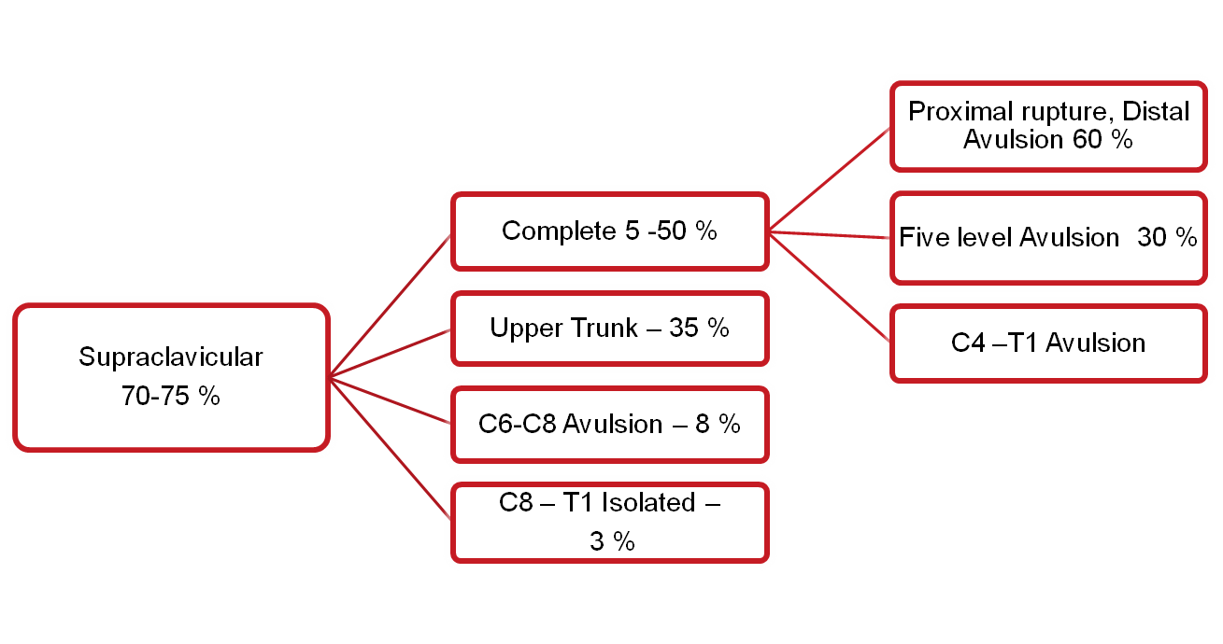
Infraclavicular
25 – 33 %
Pan BPI 45 %
Single/Combined 30 %
Isolated Nerve 25 %

Slide 35
B - Obstetric Brachial Plexus injury:
More common in :
1- Macrosomic infants -
2- When the arms are
extended over the head in
a breech presentation
3- When excessive traction
is placed on the shoulders
May be associated with I/L
Phrenic nerve injury

Slide 36
Incidence – 0.42 to 2.9 per 1000 births
TYPES –
A- Erb's palsy:
- Common
- D/t injury to C5 and C6 roots.
- Moro reflex absent
- UL drops beside the trunk, internally rotated with flexed wrist
(policeman’s or waiter’s tip hand)
Presence of the hand grasp - favorable prognostic sign

Slide 37
B- Klumpke’s palsy:
Less common
D/t injury to C7,C8 and T1 roots.
Paralysis of the muscles of the hand
and weakness of the wrist and fingers' flexors
If the sympathetic fibers of the 1st thoracic root are also injured
- paralyzed hand and ipsilateral ptosis and miosis.

Slide 38
C – Iatrogenic nerve injuries :
1- Injection injury :
- Sciatic and Radial
- More often in infants and younger children
- Direct needle injury
- Secondary constriction by scar
- Direct damage by neurotoxic chemicals
Most toxic agents - penicillin, diazepam, chlorpromazine,
tetanus toxoid, procaine and hydrocortisone
2- During surgery
Common sites: -Carpal tunnel and distal wrist
- Post. Triangle of neck, Popliteal fossa
3 - Ill fitting splint or plaster cast

Slide 39
D- Positioning & Nerve Injuries
M. C. nerves affected :
- Ulnar nerve – Most common
- Brachial Plexus
- Radial nerve
- Common peronial nerve
Compression or stretching leading to nerve ischemia
Predisposing Factors:
- Diabetes mellitus
- Cancer
- Alcoholism
- Vitamin deficiency
- Cigarette smoking

Slide 40
:INVESTIGATION : 1- ELECTRO DIAGNOSTIC EVALUATION
- EMG/NCV: TWO PARTS - Adjunct to thorough history, physical exam. and imaging study
“mild shocks and thin needles”
Ideal Time :
- After 7-10 days, neuropraxia can be distinguished from
axonotmesis
- 3 to 4 weeks after the injury (Wallerian degeneration)
with repeat study after 6 weeks

Slide 41
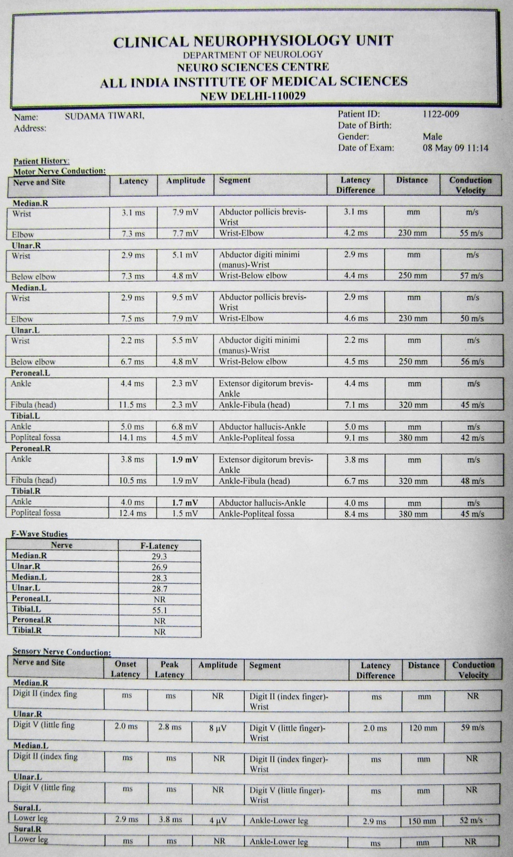
1 - Can localize the lesion to
- Ant. horn cell, Nerve root
- DRG, Plexus
- Nerve, N M junction
- Muscle
2- Lesion can also be localized to
- Cell body
- Axon
- Myelin
3- Can determine –
- Duration
- Severity
- Prognosis
4- Can provide objective measure
of – - Improvement
- Worsening

Slide 42
A- Nerve Conduction Studies (NCS)
Sensory conduction assessment – SNAP
Motor conduction assessment – CMAP
SNAP :
- More sensitive than motor conduction
studies
- Can localize a lesion as -
- Pre or postganglionic
Amplitude is “key” parameter

Slide 43
Remains Normal (on distal stimulation) in -
- No axonal loss
(conduction block,
demyelination)
- Preganglionic BPI
Normal SNAP with
numbness s/o –
- Lesion proximal to DRG
- Decrease in amplitude
s/o postganglionic
Decrease conduction
velocity in –
- Severe axonal loss
- Demyelination

Slide 44
CMAP (M wave) :
3 most imp. aspect of CMAP:
- Amplitude
- Conduction Velocity
- Distal motor latency
Normal conduction velocity –
- Arm : 50-70 m/sec
- Legs : 35-45 m/sec
Quantification of the area and amplitude
provide an estimate of the functioning
nerve and muscle.
Stimulation at proximal site causes :
- Increase latency
- Decrease amplitude and area

Slide 45
F- Wave:
- Late response of a motor unit
(20-50 m sec)
- Assess the proximal motor root
- Prolonged asymmetric F waves suggest a proximal root lesion
- Clinical application best for plexopathy
- Quite prolonged in demyelination, mild prolongation in axonal
injury

Slide 46
B- EMG :
1- INSERTIONAL ACTIVITY
- Due to injury to muscle fibre
by electrode insertion
- Lasts for two seconds
- Indicate viable muscles
- Prolonged in :
: Denervated muscle
: Myotonic disorder
: Inflammatory muscle diseases

Slide 47
2- EMG ACTIVITIES AT REST:
Normal muscle : No spontaneous resting activity
- Abnormal spontaneous potentials
Positive sharp waves, fibrillations
(Denervation Changes )
- 7-10 days (paraspinal)
- 2-4 weeks (distal muscles)
- May persist from reinnervation (4 month)
to complete atrophy

Slide 48
3- EMG FINDINGS DURING ACTIVITIES:
A- Single motor unit assessment (MUAPs)
- Sum of APs of muscle fibres of a single motor unit
- In reinnervation : Increase in size and duration of MUAP
B- Recruitment to full contraction
- Usually 20-40 MUAPs within the recording range of the
EMG needle firing at about 40 Hz with maximal
contraction
- In neuropraxia : Only recruitment changes

Slide 49
LOCALIZATION :
By two methods –
1- Detecting focal swelling or conduction block on NCSs
2- Assessing the pattern of denervation on EMG
LIMITATIONS :
- Small diameter autonomic and sensory axons cannot be tested
(for pain and temp.)
- Cannot distinguish b/w complete axonotmesis and
neurotmesis early
- Cause discomfort and are often painful

Slide 50
3- CT- myelography:
- Useful in predicting spinal nerve root avulsion in BPI
2- MRI and MR Neurography :
- Uses fast spin echo (FSE) pulse sequences on a standard 1.5 T
MRI
- Increased signal intensity in denervated muscles
(using STIR or T2 weighted pulse sequence)

Slide 51
Signal change as early as 4th day, in contrast to the 2-3
weeks in EMG
Signal changes normalize with muscle reinnervation
Useful in early differentiation from neuropraxia to high grade injury
Chronic denervation with muscle atrophy- best seen in
T1WI

Slide 52
Correlation of MRI findings with EMG/NCV
DIAGNOSTIC MODALITY | NEUROPRAXIA | AXONOTMETIS | NEUROTMETIS
NERVE CONDUCTION STUDY | Focal nerve conduction block | Initial absence of nerve conduction followed by recovery through regeneration | Persistent absence of nerve conduction
EMG | No denervation | Denervation after 2-3 wk | Persistent denervation
MR neurography | Focal signal increase | Transient signal increase distal to injury followed by normalization with axonal regeneration | Signal increase distal to injury followed by delayed normalization
MRI of muscle | Normal | Transient signal increase followed by normalization with muscle reinnervation | Transient signal increase, then reduction with atrophy and fatty infiltration

Slide 53
MANAGEMENT
CONTROVERSIES
To operate / manage conservatively ?
When to operate ?
Type of Surgery ?

Slide 54
Conservative Treatment
For Neuropraxia and mild cases of axonotmesis
- Most of the mild lesions recover within one month
AIM : Preservation of the mobility of affect limb till recovery
Components :
1- Splintage of the paralytic limb
- with position to most effectively relax the
affected muscles
Axillary N. – Shoulder abduction splint
Radial N. – Cock-up splint
Ulnar N. – Knuckle – bender splint
Sciatic N. – Food drop splint

Slide 55
2- Care of skin and nails
3- Physiotherapy :
- Full range of movement at least once every day
- Massage of paralysed muscles
- Building up of the recovering muscles
- Developing the unaffected or partially affected muscles
4- Drugs :
- Analgesics for pain
- Steroids ??
- Methylcobalamine ??

Slide 56
Surgical Treatment
Timing of surgical nerve reconstruction
(TSMJ Vol 8 2007)
A- Immediate:
- Preferred in clean cut laceration
B- Early (1 month):
- Blunt trauma or avulsion injury causing complete nerve
destruction
- Nerve ends are usually contracted and/or scars need to be
resected
C- Delayed (3-6 months):
- when the degree of injury has not yet been ascertained with
expectation as natural recovery better than surgical repair
and no signs of recovery

Slide 57
D- Late (1-2 years or more) :
- Generally only carried out for pain control, such as
neuroma resection.
After 6 months the overall results of nerve repair steadily deteriorate
Nerve reconstruction is not recommended after 18 months

Slide 58
Preoperative planning priorities
1. Review clinical examinations
2. Scrutinize electro diagnostic studies
3. Review CT myelography/imaging
4. Assemble operative team, plan for intraoperative electro
diagnostic studies
5. Plan a preoperative conference, including priorities and
contingency plans
6. Prepare patient’s expectations

Slide 59
Principles Of surgical Repair
Exposure Of Healthy nerve proximal and distal to injury
Intra operative Electrophysiological evaluation
Intraoperative microscopic examination by quick section
Fascicular /Group fascicular /Epineural microsuture technique
Avoid damage to the blood supply to the nerve
Avoid Tension
Using minimal number of sutures

Slide 60
Fibrin glue can further strengthen the anastomosis
Maximizing the number of motor fibers available for repair
Matching the graft to recipient nerve fascicles
Per-operative nerve stimulation and EMG - To establish the continuity of the nerves
If found to be in continuity – only external / internal Neurolysis is sufficient
If No NAP is recorded and microscopically the nerve appears damaged – Resection of the lesion in continuity and repair

Slide 61
Surgical treatment options
1- Neurolysis
2- Nerve repair
3- Nerve grafting
4- Neurotization
5- Nerve root replantation
6- Free Muscle and tendon transfers

Slide 62
Neurolysis
Used to decompress nerves from internal fibrosis or from surrounding
tissue
Effective only if scar tissue seen around nerve or inside epineurium,
preventing recovery or causing pain
External Vs Internal

Slide 63
Management of Neuroma in continuity
Resected until normal looking nerve tissue is present
If it extends to the root level – some sort of Neurotization required
According to published results, some recommend resection and nerve grafting with int. neurolysis,
whereas others maintain that
neurolysis is beneficial, esp. if
intraoperative electrophysiological
testing reveals significant conduction
across the neuroma

Slide 64
Nerve Repair Magnification, micro-sutures and micro instruments considerably improved the results in nerve repairs.
Primary Repair
Sooner the better
Tissue dissection away from nerve
In secondary repair – dissection from normal to injured area
Ragged ends –pared.
Use microscope and 10\0 suture.

Slide 65
Suture epineurium in background of glove piece
Epineural vs perineural repair (slightly superior)
- Orgel and Terzies, 1977
Sutureless anastomosis :
-Laser welding
-Tubular/ cuff union
-Tissue adhesives
(May reduce scar tissue
No definitive improved functional results)
Splinting for 3-4 week

Slide 66
Nerve Grafting
Indicated for well defined nerve ends with gap
Intraoperatively a good fascicular pattern should be seen after the neuroma is excised
Donor nerves
- Sural nerve - M. C, (single\cable)
- Cutaneous nerves of arm and forearm
- Dorsal sensory branch of radial nerve
- Distal portion of ant. interosseous nerve.
Graft orientation should be reversed to minimize axonal branch loss

Slide 67
For success of nerve grafts –
- small, thin grafts used
(vascularized faster)
Length of graft –
Best result - upto 4 cm
Not to be used > 8 cm
For gaps (> 20 cm) with associated
soft tissue loss over the repaired
area, current recommendation –
- free vascularized nerve grafts
Good Results in 70 % cases
(Stellini L. Brit. J.Plas. Surg.
1982; 35:478-482)

Slide 68
Types of graft
Cable nerve graft
Group interfascicular nerve graft
Free neurovascular nerve graft
Pedicle nerve graft
Tubal graft

Slide 69
Nerve Transfer
Indicated for root avulsions of brachial plexus.
Spinal accessory to suprascapular nerve.
Intercostal nerves to musculocutaneous nerve
Medial pectoral to musculocutaneous nerve
Descending cervical plexus to upper and middle trunk

Slide 70
Tendon Transfer
Motor end plate must have degenerated
(i.e. 18 – 24 months after injury)
Assess
Muscles – lost
Muscles – available
Donor Muscle
Expendable
Adequate power
Synergistic
Transferred tendon
Routed subcutaneously
Straight pull

Slide 71
Principle in surgical management of BPI
AIMS OF SURGERY
‘To a man with nothing, a little can be a lot’
Depends on what is lost, what is needed and what is possible
In pan BPI –
- first goal of the surgery is to obtain shoulder stabilization and abduction and an active elbow flexion , while extension is achieved from gravity
In a Meta-analysis of literature involving nerve transfers shoulder abduction is best restored by XI Nerve – SS anastomosis, while elbow flexion is best regained using IC Nerves without grafts ( R. Midha . Neurosurgery Focus. Vol 16; May 2004 )

Slide 72
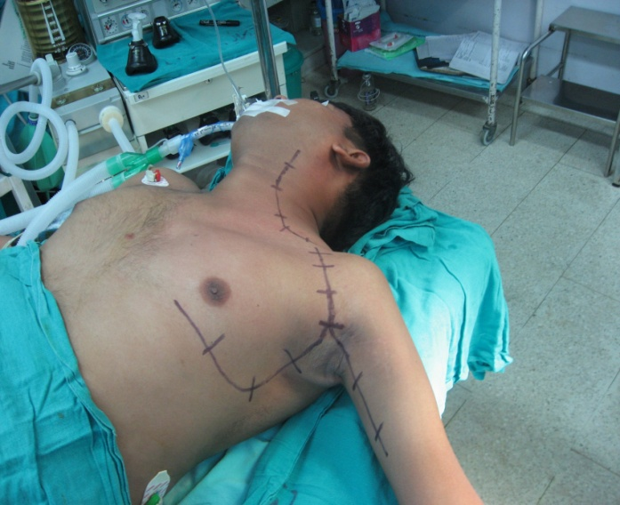
Options for Neurotization
Suprascapular : Phrenic
Spinal accessory
C7 fascicle
Axillary : Phrenic
Spinal Accessory
Medial pectoral
Musculocutaneous: Ulnar
Intercostal
Medial pectoral
Oberlin Technique - Biceps reinnervation
using some ulnar nerve fascicles
- flexor Carpi ulnaris

Slide 73
Post operative Care
3-6 weeks immobilization
Physiotherapy
Electrical stimulation
Re- education of muscles
Follow up Electro diagnostic studies
Occupational therapy
Limb reconstruction
Psychotherapy

Slide 74
PROGNOSIS
DEPENDS ON :
TYPE OF LESION
LEVEL OF LESION
TYPE OF NERVE
SIZE OF GAP
AGE
TIME OF SURGERY
ASSOCIATED LESION
SURGICAL SKILL

Slide 75
: Recent Advances :
1- Endoscopic technique for harvesting the sural nerve
( Eich BS et al, J Reconstr Microsurg 2000; 16: 329-31)
Adv: Avoids long unaesthetic scar
wound infection
wound pain
Disadv:
Cost of the equipment
Long learning curve

Slide 76
2- Nerve Allografts:
(Mackinnon SE et al, Plast Reconstr Surg 2001)
Acellular nerve graft
Removal of components that would cause rejection
(tissue sources: cadaver, animal)
Nerve naturally re-grows on its own “skeleton”
Natural tissue chemically and physically aids nerve regeneration
Adv:
- Avoids use of nerve graft from patient
- Minimizes time of procedure
- Option for previous “non-operable” cases
- Familiar to surgeons and easy to handle
- Easily modified

Slide 77
3- Nerve conduits
(Ashley WW et al,J Neurosurg 2006; 106: 452-6)
Direct axonal sprouts from the proximal to the distal nerve stump
Channel for diffusion of neurotropic and neurotrophic factors
Constructed from:
- Polylactide-co-caporolactone
- Polyglycolic acid
- Silicone
- Laminin, Collagen
(Biological, degradable)

Slide 78
4- Fibrin glue in nerve repair
( Narakas A. Orthop Clin North Am,1988)
Less inflammatory response
Better axonal regeneration
Better fiber alignment
No definitive e/o improved functional results
5- Nerve Growth Factors (Midha R et al, Neurosurg 2003)
- Neurotrophins
- Glial-cell-line derived neurotrophic factor ligands (GLFs)
- Neuropoietic cytokines
Enhance regeneration and increase the nerve gap that can be
bridged (to 15 mm)

Slide 79
TAKE HOME MASSAGE
Management of nerve injury requires through anatomical
knowledge and function with complete pre operative work up
No alternative to a proper and through neurological examination
Controversies exist regarding optimum management thus every
case to be individualized
Magnification, micro-sutures and micro instrument considerably
improved the results

